Slide 1

OmniRAG
Multi-Agent Search
Engine for Documents
Grounded, citation-backed answers over your document corpus — hybrid retrieval, LangGraph multi-agent reasoning, and zero cross-project leakage.
React 19
FastAPI
LangGraph
FAISS / Qdrant
Notes:
OmniRAG is a LangGraph multi-agent search engine that produces grounded, citation-backed answers over a document corpus using hybrid retrieval and strict project scoping.

Slide 2
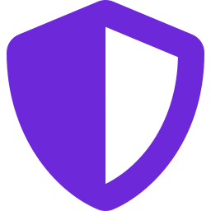
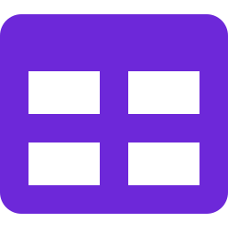
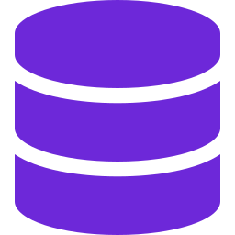
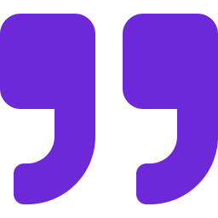
// THE PROBLEM
Naive RAG breaks on real document corpora
Cross-project leakage
Tables get shredded
One project’s specs bleed into another project’s answers — trust collapses.
Vector chunking fragments structured tables; the model reads noise, not data.
No structured facts
Unverifiable answers
“What’s the budget?” needs exact SQL precision, not fuzzy similarity.
Responses without traceable citations can’t be audited or defended.
Notes:
Generic RAG fails on real corpora in four ways: cross-project leakage, fragmented tables, no structured-fact precision, and unverifiable citations. OmniRAG is built to fix all four.

Slide 3




// THE SYSTEM
Four decoupled components, one answer
A modular web application that separates presentation, orchestration, and storage — so each part scales and swaps independently.
01
02
03
04
React Dashboard
FastAPI Gateway
Dual Storage
Multi-Agent RAG
React 19 + Vite + Zustand. SSE streaming answers, cached REST via TanStack Query.
Strict 4-layer Onion architecture — frameworks decoupled from business logic.
Relational (Postgres/SQLite) for facts + Vector (FAISS/Qdrant) for meaning.
LangGraph state machine orchestrates analyze → retrieve → build → stream.
Notes:
OmniRAG has four decoupled parts: a React dashboard, a FastAPI onion-architecture gateway, dual relational-plus-vector storage, and a LangGraph multi-agent RAG engine.

Slide 4
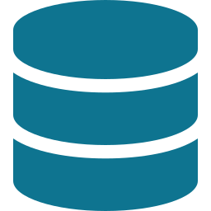
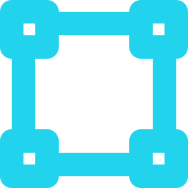
// ARCHITECTURE
One gateway, four concentric layers
React 19 Frontend · SSE streaming · TanStack Query cache
Presentation
FastAPI controllers, routers, middleware, request/response models
Application
Business use-cases, services, LangGraph orchestration, schemas
Domain
SQLAlchemy models + repository & vector-store interfaces (contracts)
Infrastructure
FAISS/Qdrant persistence, ORM repos, LLM providers, OCR, cache
Relational DB — Postgres / SQLite
Vector DB — FAISS / Qdrant
Notes:
The backend is a strict 4-layer Onion architecture — Presentation, Application, Domain, Infrastructure — sitting between the React frontend and the dual storage layer. Frameworks stay decoupled from business workflows.

Slide 5


// DESIGN DECISION
Why two databases, not one
Relational DB
Vector DB
Postgres / SQLite
FAISS / Qdrant
ACID app state, sessions & audit trails
Semantic proximity over dense vectors
Structured facts: budget, timeline, tables
Cosine / dot-product similarity at scale
Multi-tenant foreign-key scoping
384-d embeddings (all-MiniLM-L6-v2)
Lexical BM25 search over raw chunks
Local flat index or cloud cluster
Fused in one workflow: exact multi-tenant scoping and factual lookups, layered with deep conceptual matching — via Hybrid RRF.
Notes:
Relational databases give ACID guarantees, foreign-key multi-tenant scoping and structured facts. Vector databases give semantic similarity. OmniRAG uses both, fused through Hybrid Reciprocal Rank Fusion.

Slide 6





// ORCHESTRATION
A LangGraph multi-agent pipeline
POST /api/v1/chat/stream · a stateful agent graph turns a question into a grounded, streamed answer.
Query Analyzer
Retriever
Prompt Builder
LLM Streamer
Classifies intent, extracts entities
Harvests context from all sources
Synthesises context + citations
Streams tokens back over SSE
↺ Persistence: every exchange — query, context, response, citations — is saved to Session & SearchHistory. Conditional edges short-circuit structured queries.
Notes:
The LangGraph state machine runs four agents in sequence — Query Analyzer, Retriever, Prompt Builder, LLM Streamer — then persists the exchange. Conditional edges let structured queries short-circuit to a fast path.

Slide 7
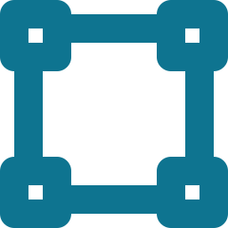




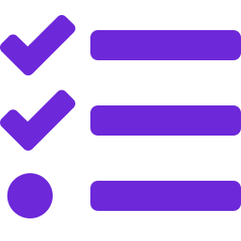
// SMART ROUTING
Six intents, two retrieval paths
OmniRAG never runs a generic search. It classifies intent first, then routes to the cheapest correct strategy.
Structured → SQL shortcut
Knowledge → hybrid retrieval
Deterministic lookups on the DocumentFact table — bypasses vector search entirely.
Multi-source harvesting with project scoping — vector, lexical, graph and tables.
BUDGET
Direct SQL on DocumentFact
TECHNOLOGY
Hybrid RRF + graph traversal
TIMELINE
Direct SQL on DocumentFact
FACTUAL
Hybrid RRF (vector + lexical)
DELIVERABLES
Direct SQL on DocumentFact
GENERAL
Hybrid RRF (vector + lexical)
Notes:
The Query Analyzer sorts every question into one of six intents. Budget, timeline and deliverables go straight to SQL for deterministic answers; technology, factual and general questions go through hybrid retrieval.

Slide 8


// THE ENGINE
Three techniques that make it accurate
Hybrid RRF
Target Filtering
Table Matcher
Dense vectors capture meaning; BM25 catches exact strings & code symbols. Reciprocal Rank Fusion merges both rankings.
Query entities matched against DocumentEntity → scope every search strictly to those doc_ids. No cross-project leakage.
Tables extracted whole at ingest, keyword-scored at retrieval, and prepended un-fragmented so the LLM sees complete data.
1 / (60 + rank), summed
filter_doc_ids = [...]
fact_type = "table"
Notes:
Three techniques drive accuracy: Hybrid RRF fuses vector and BM25 rankings with k=60; Target Document Filtering scopes searches to matched project doc_ids to stop leakage; the Table Matcher keeps structured tables whole.

Slide 9

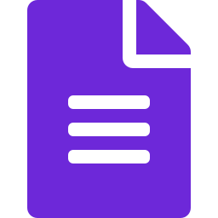
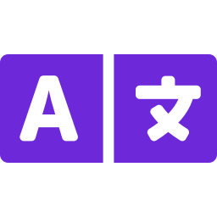

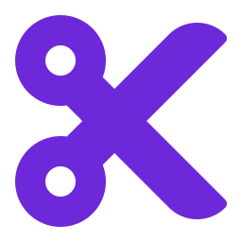
// INGESTION
From upload to searchable in one async pass
POST /api/v1/documents/upload returns 202 Accepted instantly; a background worker does the heavy lifting.
1
2
3
4
5
6
Upload
→
Parse
→
OCR fallback
→
Extract
→
Chunk
→
Embed + Index
Multipart file → queued
MarkItDown → markdown
Scanned / image files
Metadata + taxonomy (LLM)
Recursive 400 / 100
MiniLM 384-d → FAISS/Qdrant
Supported: PDF · DOCX · PPTX · XLSX · TXT · HTML · CSV · MD + image scans (PNG/JPG/TIFF) via pluggable OCR (EasyOCR · Tesseract · Vision-LLM).
Notes:
Ingestion is a single async pass: the upload returns 202 immediately, then a worker parses with MarkItDown, falls back to OCR on scans, extracts metadata and taxonomy via LLM, chunks at 400/100, and embeds with MiniLM into FAISS or Qdrant.

Slide 10


// STACK
Built on a modern, swappable stack
Frontend
Backend
AI / RAG
React 19 · Vite · TypeScript · Tailwind · Zustand · TanStack Query
FastAPI · Pydantic · SQLAlchemy async · JWT · bcrypt
LangGraph · LangChain · sentence-transformers · BM25Okapi · RRF
LLM providers
Storage
Ingestion
Groq · OpenRouter · LM Studio · Ollama · Vision-LLM OCR
PostgreSQL / SQLite · FAISS / Qdrant · Redis cache
MarkItDown · EasyOCR · Tesseract · MiniLM embeddings
Notes:
The full stack: React 19 front end; FastAPI backend; LangGraph and LangChain for the RAG engine; multiple swappable LLM providers; dual relational and vector storage with Redis; and a MarkItDown-plus-OCR ingestion pipeline.

Slide 11
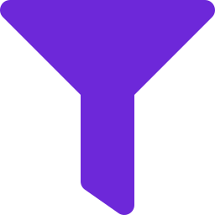
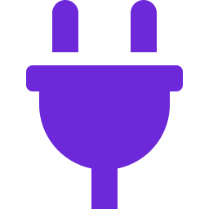

// IN SUMMARY
Precise, grounded, and yours to deploy
Zero leakage — Strict per-project scoping on every query
Every claim cited — Numeric citations trace back to source docs
Facts stay exact — Structured budget/timeline via SQL, not guesswork
Tables intact — Structured data reaches the model un-fragmented
Swappable everywhere — OCR, LLM and vector store chosen via .env
Self-hostable — Local FAISS + Ollama, or cloud Qdrant + Groq
OmniRAG — grounded answers over your documents, with the accuracy that real corpora demand.
Notes:
In summary: OmniRAG delivers zero cross-project leakage, cited answers, exact structured facts, intact tables, fully swappable components, and self-hostable deployment.

